Slide 1


Day 22
Math24 (Differential Equations)
Ch 3.6 Variation of Parameters; Second Order (Page 186-192)
Elementary Differential Equations and Boundary Value Problems, 10th edition, by William E. Boyce and Richard C. DiPrima, ©2013 by John Wiley & Sons, Inc.

Slide 2


Recall the nonhomogeneous equation
where p, q, g are continuous functions on an open interval I.
The associated homogeneous equation is
In this section we will learn the variation of parameters method to solve the nonhomogeneous equation. As with the method of undetermined coefficients, this procedure relies on knowing solutions to the homogeneous equation.
Variation of parameters is a general method, and requires no detailed assumptions about solution form. However, certain integrals need to be evaluated, and this can present difficulties.

Slide 3



Example 1: Variation of Parameters (1 of 6)
We seek a particular solution to the equation below.
We cannot use the undetermined coefficients method since g(t) is a quotient of sin t or cos t, instead of a sum or product.
Recall that the solution to the homogeneous equation is
To find a particular solution to the nonhomogeneous equation, we begin with the form
Then
or

Slide 4


Example 1: Derivatives, 2nd Equation (2 of 6)
From the previous slide,
Note that we need two equations to solve for u₁ and u₂. The first equation is the differential equation. To get a second equation, we will require
Then
Next,

Slide 5
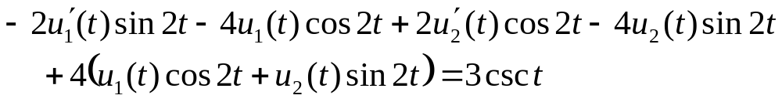
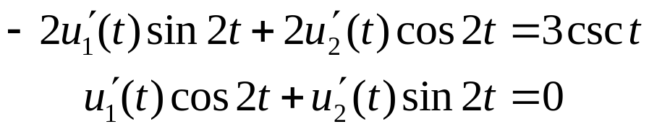
Example 1: Two Equations (3 of 6)
Recall that our differential equation is
Substituting y'' and y into this equation, we obtain
This equation simplifies to
Thus, to solve for u₁ and u₂, we have the two equations:

Slide 6

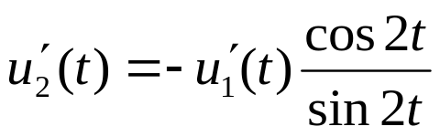
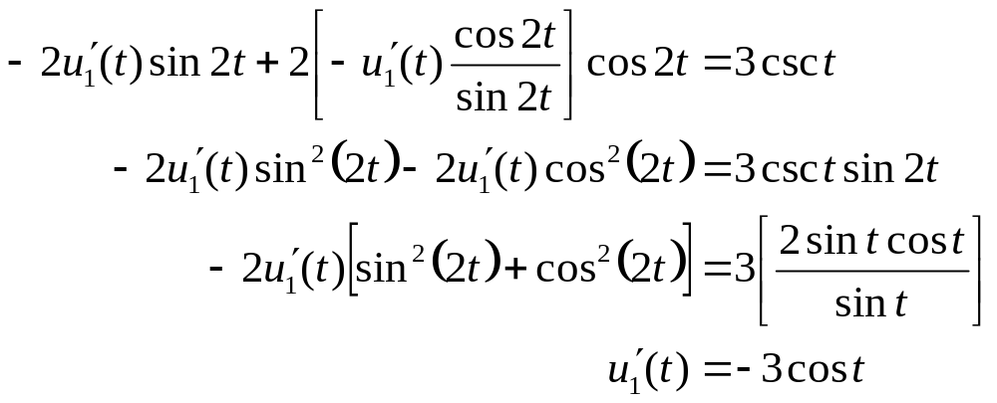
Example 1: Solve for u₁' (4 of 6)
To find u₁ and u₂ , we first need to solve for
From second equation,
Substituting this into the first equation,

Slide 7
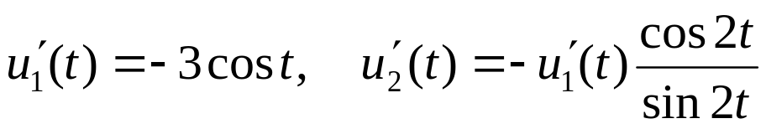
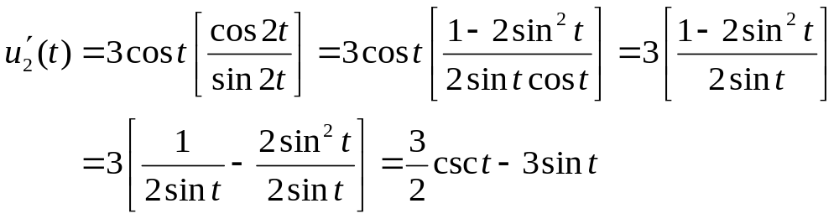
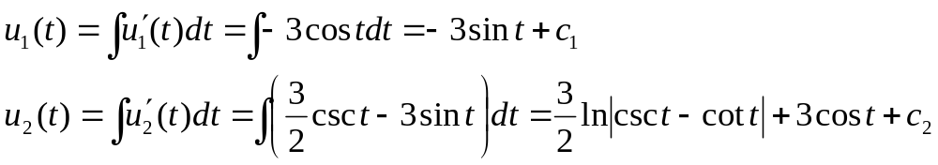
Example 1: Solve for u₁ and u₂ (5 of 6)
From the previous slide,
Then
Thus

Slide 8
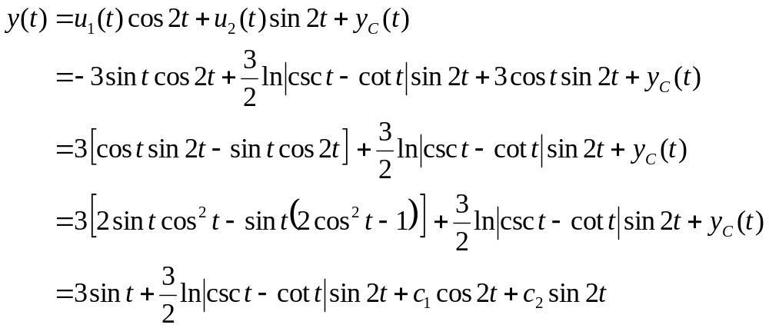
Example 1: General Solution (6 of 6)
Recall our equation and homogeneous solution y_{C}:
Using the expressions for u₁ and u₂ on the previous slide, the general solution to the differential equation is

Slide 9
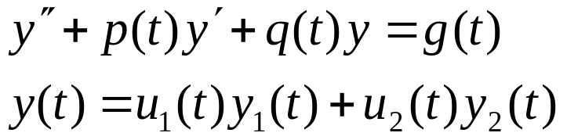
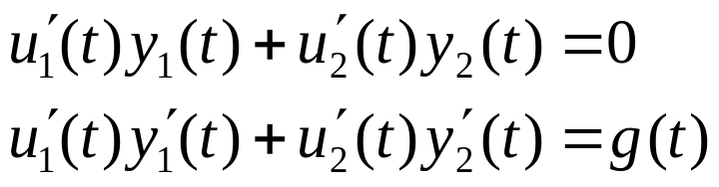
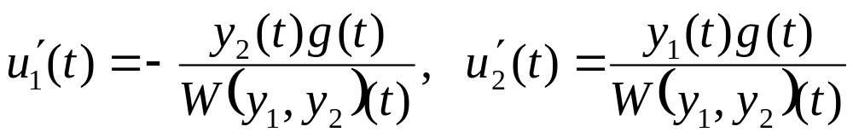
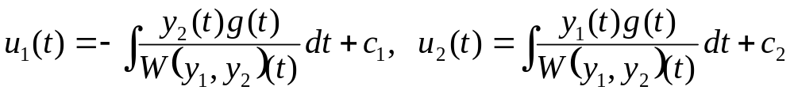
Summary
Suppose y₁, y₂ are fundamental solutions to the homogeneous equation associated with the nonhomogeneous equation above, where we note that the coefficient on y'' is 1.
To find u₁ and u₂, we need to solve the equations
Doing so, and using the Wronskian, we obtain
Thus

Slide 10
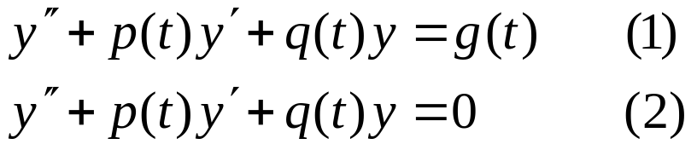
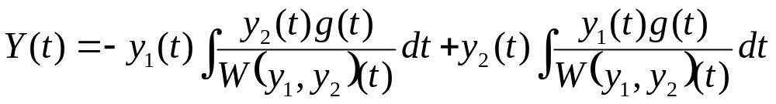

Theorem 3.6.1
Consider the equations
If the functions p, q and g are continuous on an open interval I, and if y₁ and y₂ are fundamental solutions to Eq. (2), then a particular solution of Eq. (1) is
and the general solution is

